Slide 1









CREDIT CARD FRAUD DETECTION
Graduation Project

Slide 2

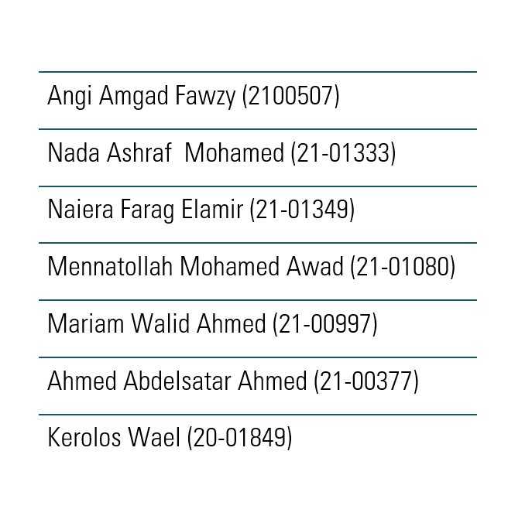


TEAM MEMBERS
1
2
3
4
5
6
7

Slide 3

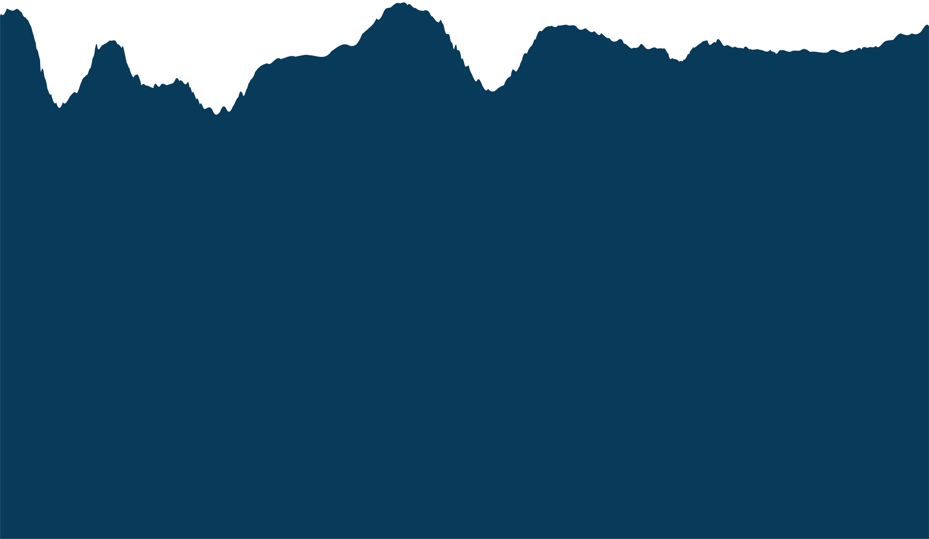



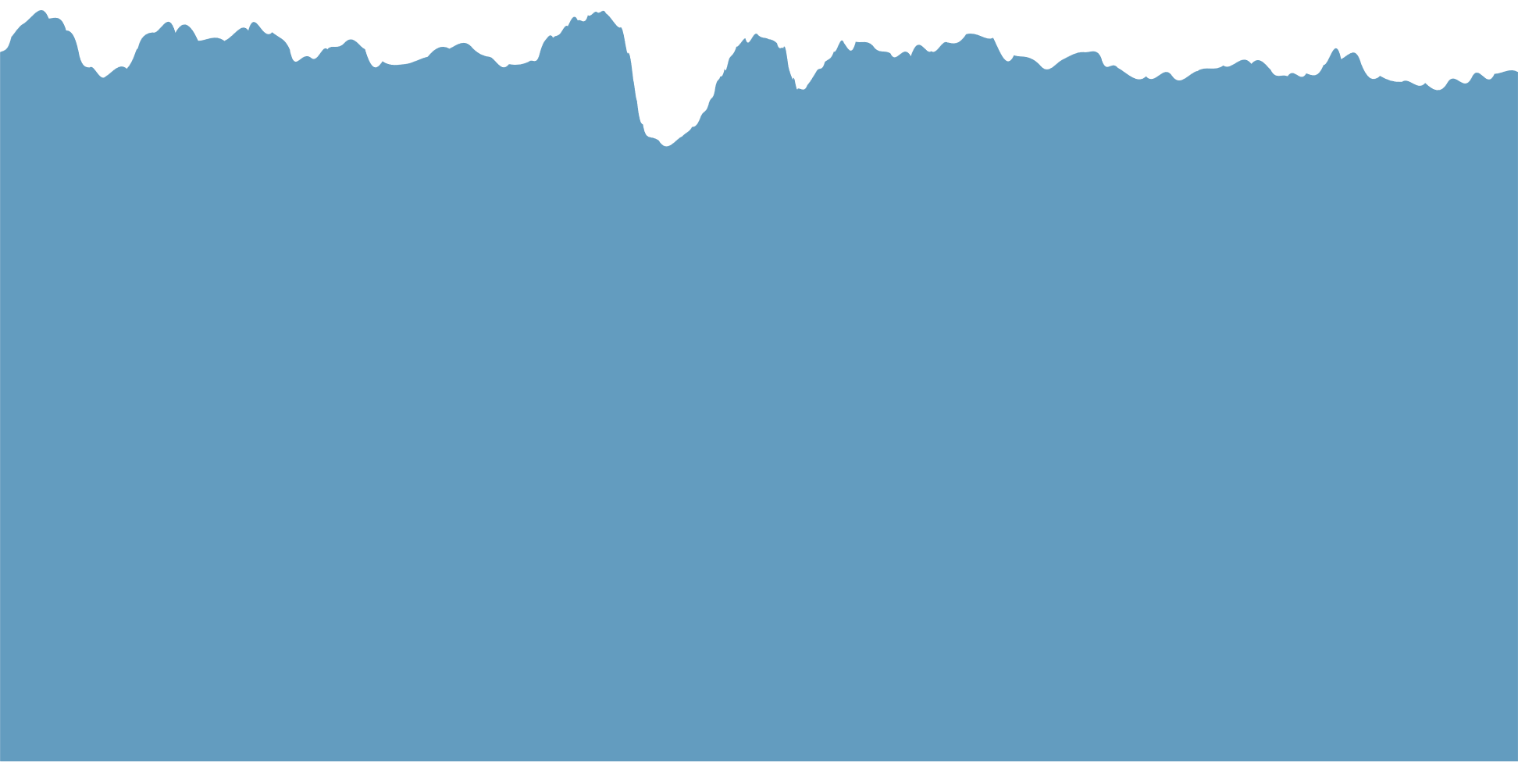
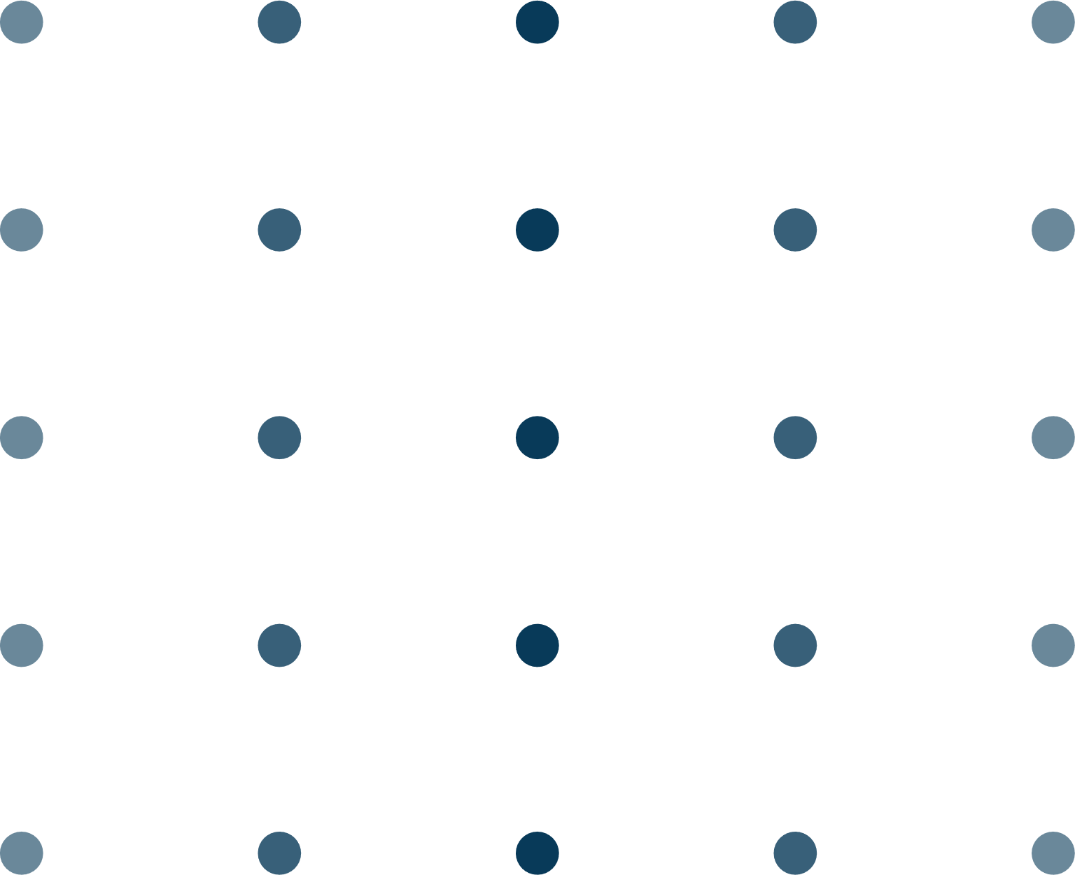

TABLE OF CONTENTS
01
Introduction
02
Project Overview
03
Data set and Preprocessing
04
Machine Learning Models
05
Deep Learning Model (DNN)
06
System Architecture
07
Website Front-End
08
Website Back-End
09
Project Schedule
10
Conclusion

Slide 4
Introduction

Slide 5


Credit card fraud is a big problem today, leading to huge money losses. Our project helps detect fake online transactions using smart computer models. We also created a website to show our results in a simple way.

Slide 6
Project Overview

Slide 7
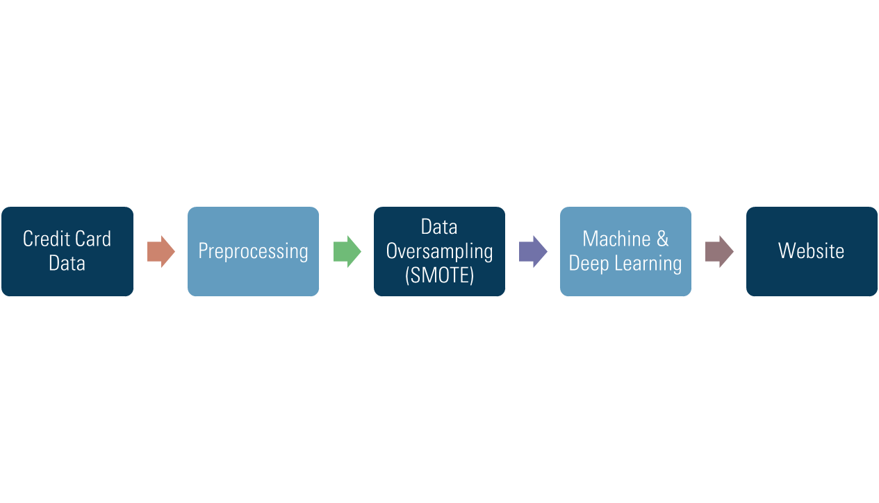
PROJECT OVERVIEW

Slide 8
Dataset &
Preprocessing

Slide 9
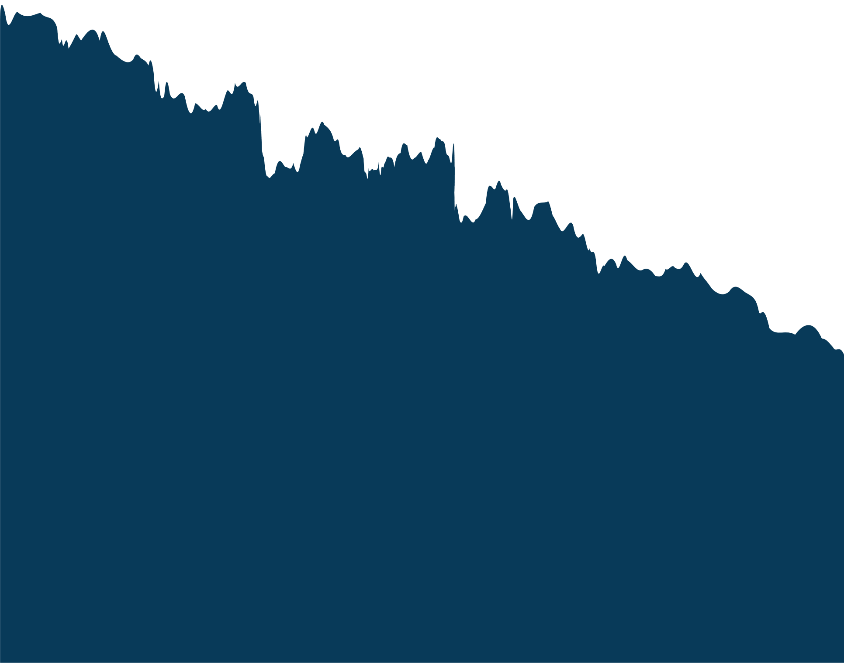
DATASET FEATURES
1 | Step ”Int”
2 | Type “String”
3 | Amount “Int”
4 | nameOrig “String”
5 | oldbalanceOrg “Int”
6 | newbalanceOrig “Int”
7 | nameDest “String”
8 | oldbalanceDest “Int”
9 | newbalanceDest “Int”
10 | isFraud “Boolean”

Slide 10


THE DETAILS OF DATASET
Dataset name Online Payments Fraud Detection
Rows
6362620
Columns
11
The dataset is divided into Fraud cases and Valid Transactions.
The initial values were:
1.Fraud cases: 8213
2.Valid transactions: 6354407

Slide 11


TECHNIQUE SMOTE
We used Synthetic Minority Oversampling Technique (SMOTE) to balance the dataset.

Slide 12
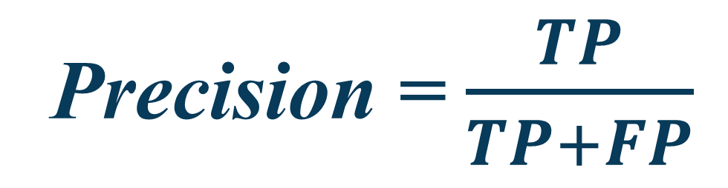

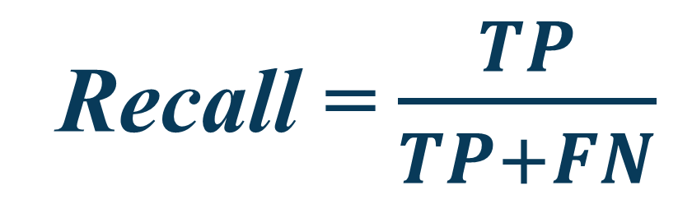
Evaluation Metrics
Precision : Measures how many of the predicted fraud cases were actually fraud.
Precision = $\frac{TP}{TP+FP}$
Recall : Measures how many actual fraud cases were detected.
Recall = $\frac{TP}{TP+FN}$
F1 Score: Balances Precision and Recall.
F1 Score = 2 × $\frac{Precision × Recall}{Precision + Recall}$

Slide 13
Machine Learning Models

Slide 14




MACHINE LEARNING MODELS
logistic Regression: is primarily used in classification tasks it predicts only 2 outcomes (1, 0) Its fast to train and Suitable for large datasets

Slide 15

MACHINE LEARNING MODELS
Logistic regression
Train Accuracy | 0.94357
Validation accuracy | 0.94355
Test Accuracy | 0.9438
Precision | 0.9440
Recall | 0.9438
F1 Score | 0.94388

Slide 16
MACHINE LEARNING MODELS
Decision Tree: is used for both classification and regression tasks; it splits data into subsets based on the most significant features. It identifies fraudulent transactions by analyzing patterns like history and user behavior.

Slide 17
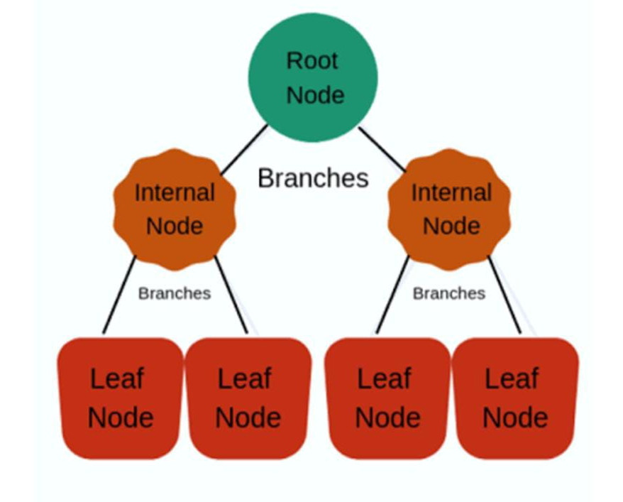
MACHINE LEARNING MODELS
Decision Tree:

Slide 18
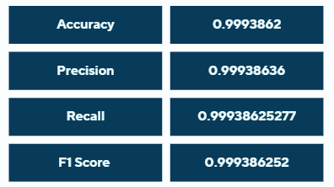
MACHINE LEARNING MODELS
Decision Tree:

Slide 19
Deep Learning

Slide 20
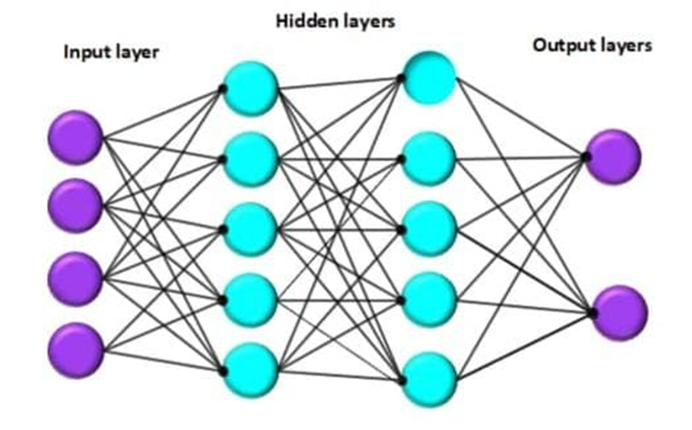
DEEP LEARNING MODEL
Dense Neural Network (DNN), it got multiple layers between input and output allowing them to learn complex patterns from large amount of data.

Slide 21
Model Architecture
Input Layer (9 features) → Represents transaction details.
Hidden Layers:
64 Neurons (ReLU Activation) + L2 Regularization → Helps in feature extraction.
Batch Normalization → Speeds up training & improves stability.
Dropout (50%) → Prevents overfitting.
32 Neurons (ReLU) + Batch Normalization 16 Neurons (ReLU)
Output Layer (Sigmoid Activation)
Outputs a probability (0 = non-fraud, 1 = fraud).

Slide 22
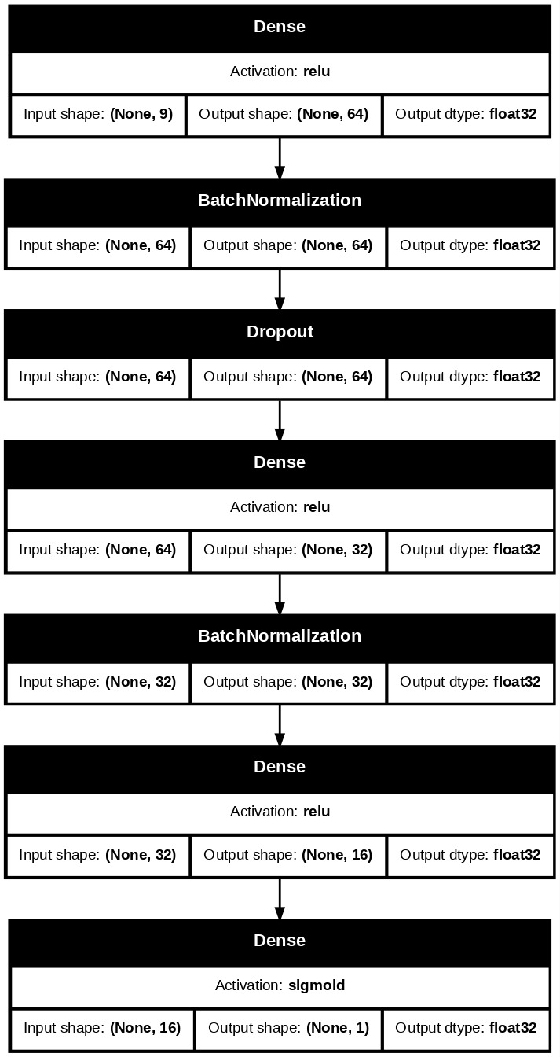

Slide 23
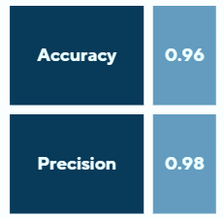
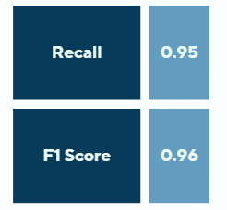
DEEP LEARNING MODEL
Number of Epochs: 50
Batch size: 64
Early Stopping

Slide 24
System Architecture

Slide 25
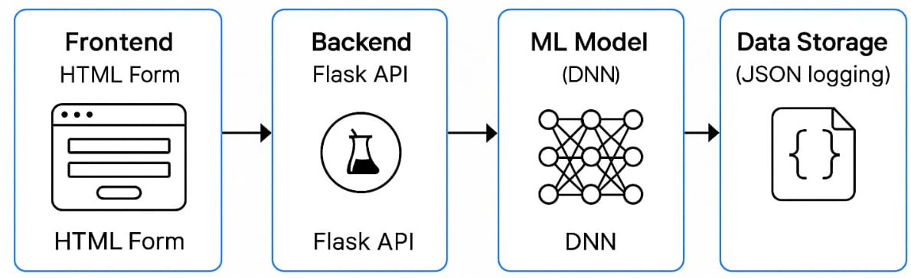
System Architecture Diagram

Slide 26
Website Front-End

Slide 27

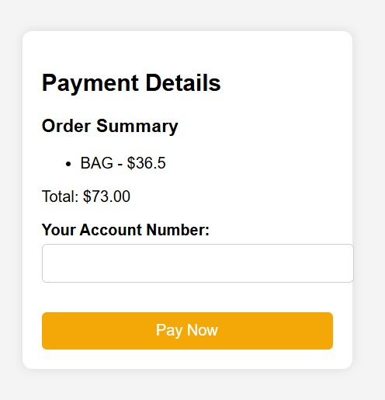

Slide 28
Website Back-End

Slide 29
We used Flask that acts as the backend server that:
Extracts features by searching the transaction ID (nameOrig) in the CSV
2
4
Loads the trained DNN model using TensorFlowRuns
Sends result back as JSON
Receives transaction data from the user
Prediction on the received data
1
3
5

Slide 30
Logging Predictions
Each transaction and its result are saved in a JSON file (payment_history.json).
This allows future analysis or tracking.
Mimics what a real payment gateway might store.

Slide 31
Conclusion

Slide 32

Our system uses machine learning and deep learning to detect fraud effectively. The website makes it easy for users and businesses to check transactions in real time. This helps improve security and reduce financial losses from fraud.

Slide 33
Project Schedule

Slide 34
SCHEDULE OF OUR WORK
Task
Duration
Task
Duration
Searching for Dataset | 17th-26th October
Preprocessing the Data | 2nd-9th November
Searching for machine learning models | 30th November-7th December
Working on the models | 8th -20th December
Searching for Deep learning models | 21st – 23rd December
Working on Deep learning | 24th–29th December
Working on Website frontend | 2nd-9th November
Searching for machine learning models | 25th January-1st February
Working on perfecting overall project | 3rd – 7th February
Back-End website connection to model Payment History | 6th March - 10th April 10th April – 15th April

Slide 35
Demo

Slide 36
Thank You

